Slide 1
Parameter-efficient Fine-tuning
龚卓成
Notes:
部署方便
数据不充足时对抗过拟合

Slide 2
Outlines
On the Effectiveness of Adapter-based Tuning for Pretrained Language Model Adaptation (ACL 2021)
LoRA: Low-Rank Adaptation of Large Language Models
(ICLR under review)
Towards A Unified View of Parameter-Efficient Transfer Learning (ICLR under review)

Slide 3
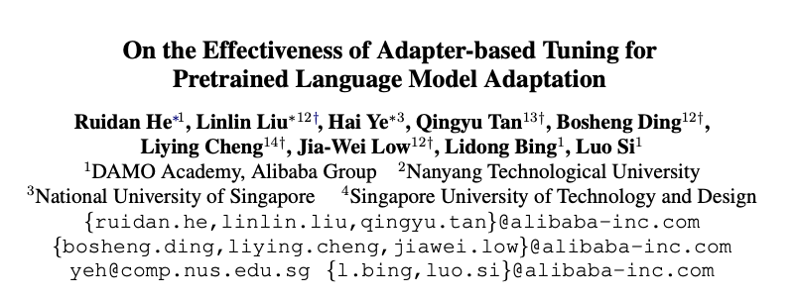

Slide 4
Motivation
Fine-tuning vs. Adapter-based tuning
Existing work mostly focuses on the parameter-efficient aspect of adapters
outperforms fine-tuning on low-resource and cross-lingual tasks
more robust to overfitting

Slide 5
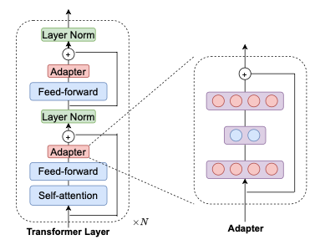

Adapter-based Tuning
Adapter
Down-project (dimension d to m)
Up-project (dimension m to d)
Parameter update
adapters
normalization layers
final classification layer

Slide 6
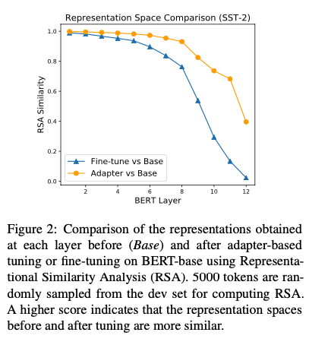
Adapter Better Regularizes Tuning
Fine-tuning PLM suffer from overfitting and bad generalization issues
catastrophic forgetting
Notes:
图是中间层表示在ft前后的变化

Slide 7
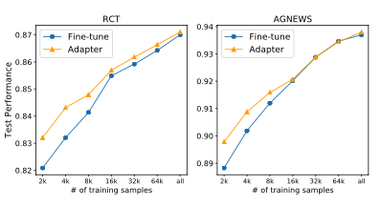
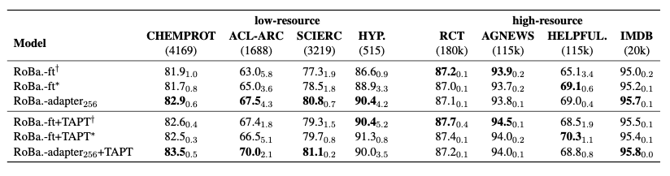
Monolingual Adaptation
Task Adaptation Evaluation (TAE)
Notes:
TAPT - task-adaptive pretraining
低资源adapter表现更好，高资源55开（可能只是因为参数少，不容易过拟合）

Slide 8
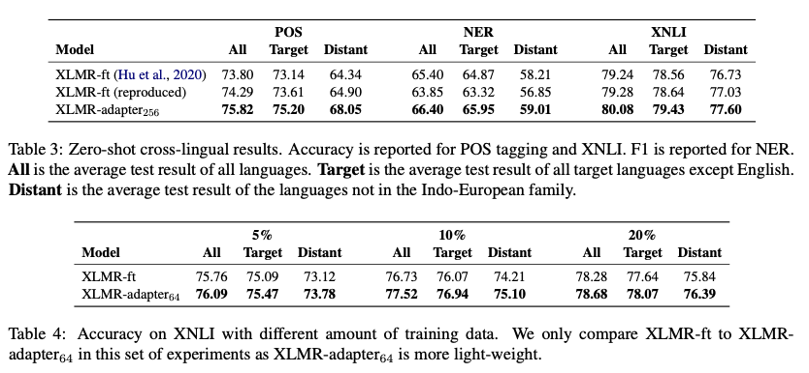
Cross-lingual Adaptation
The ability to mitigate forgetting is more useful in cross-lingual scenarios
Notes:
只在英语文本上微调，其它语言是zero-shot
Adapter效果一直比ft好，高资源也是

Slide 9
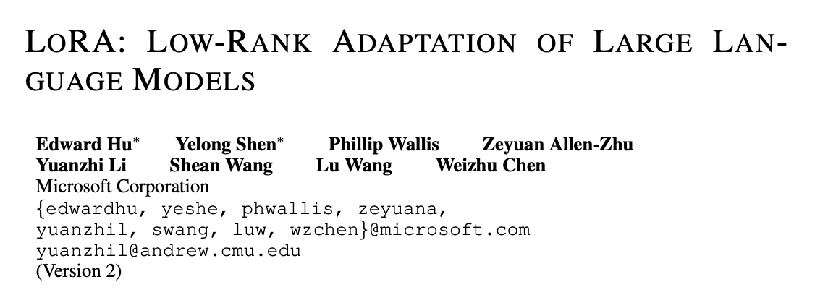

Slide 10
Existing Solutions
Adapters
Adapter Layers Introduce Inference Latency
Prefix tuning (Prompt)
Prefix tuning is difficult to optimize and that its performance changes non-monotonically in trainable parameter
Notes:
在原始输入前拼接几个虚拟的token，

Slide 11

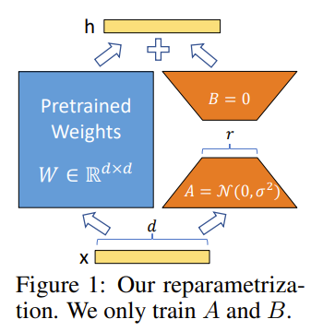
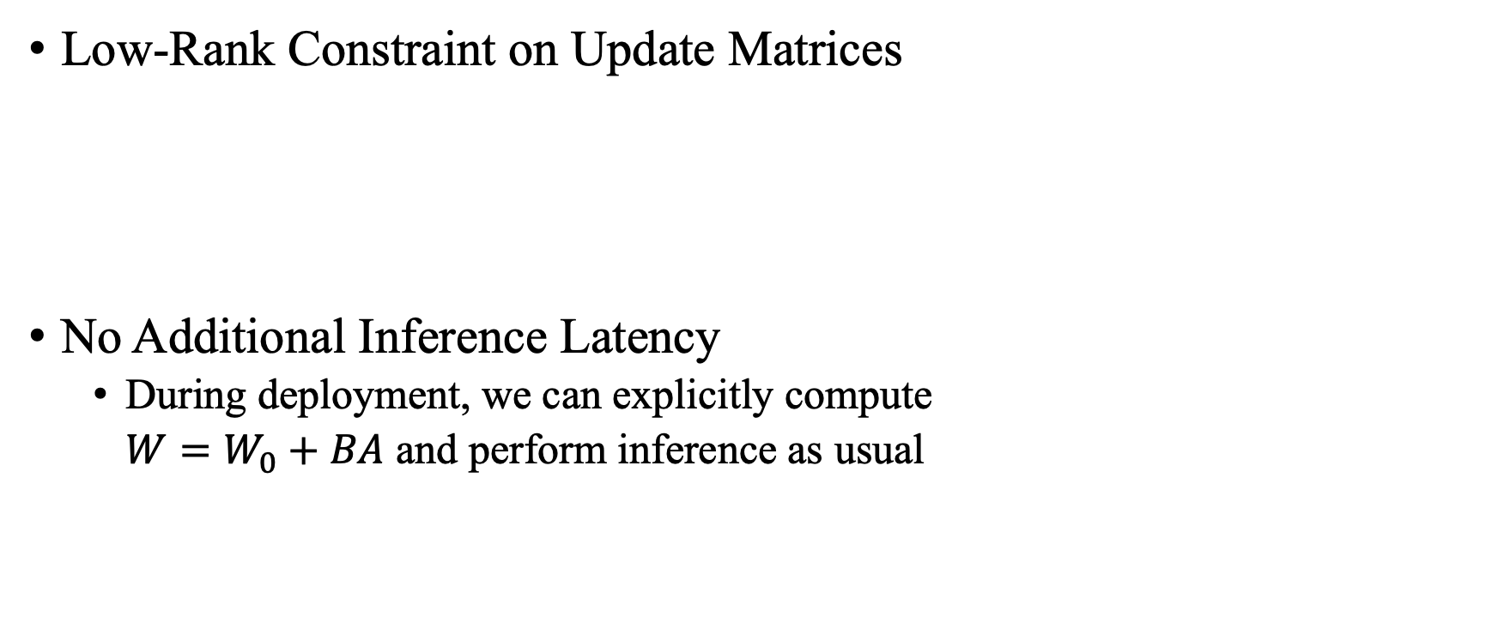
Method
Low-Rank Constraint on Update Matrices
No Additional Inference Latency
During deployment, we can explicitly compute
$W=W_{0}+BA$ and perform inference as usual
Notes:
Lora是针对每个参数矩阵的，不同于adapter
Ft时参数的变化是低秩的

Slide 12

Applying LoRA to Transformer
Only changing the attention weights
Freeze ffn

Slide 13
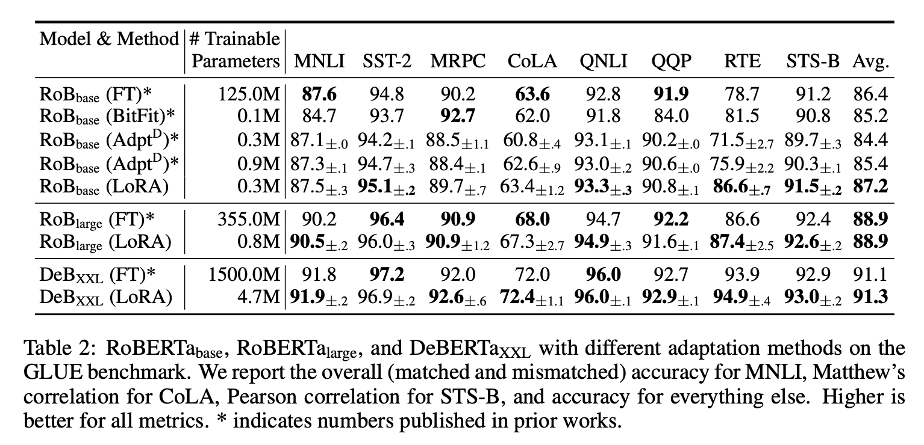
Experiments

Slide 14
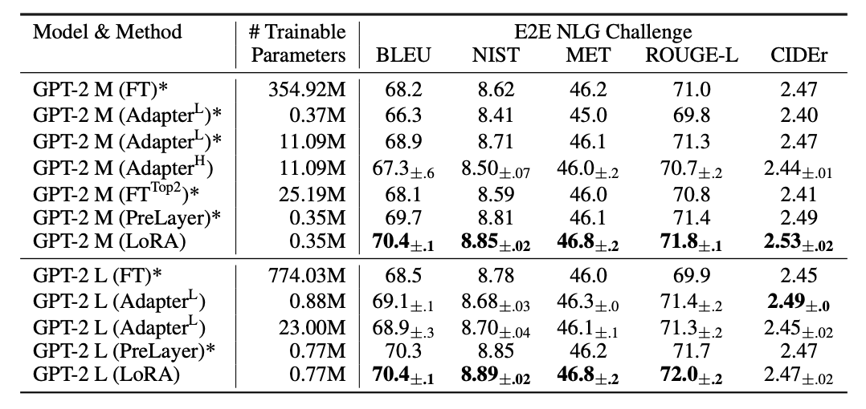
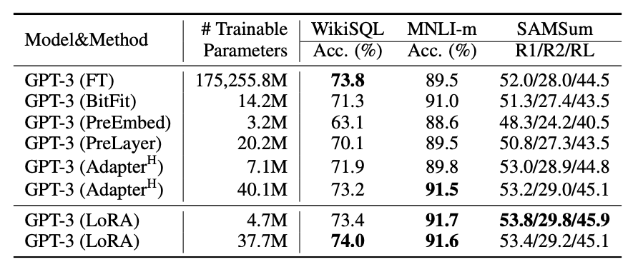

Slide 15
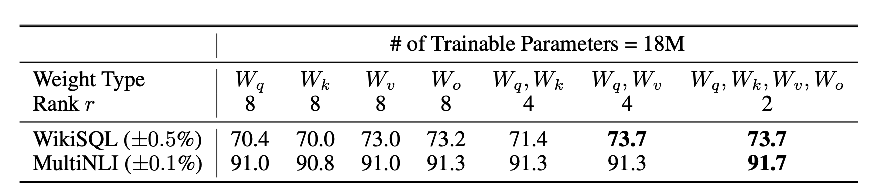
Which weight matrices should we apply to ?

Slide 16
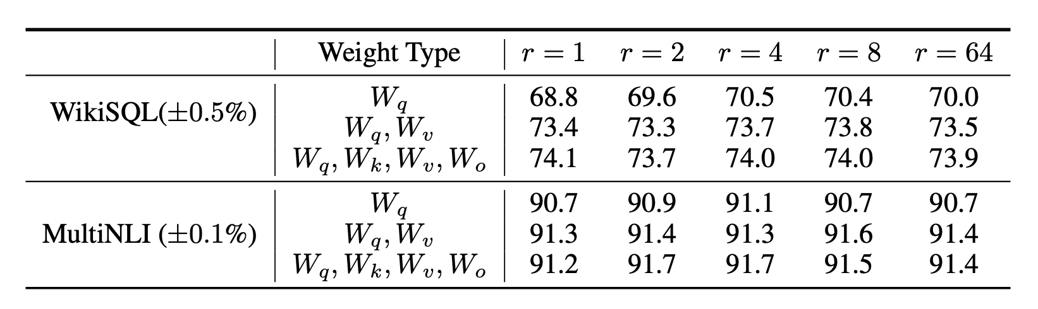
What is the Optimal Rank r for LoRA?

Slide 17
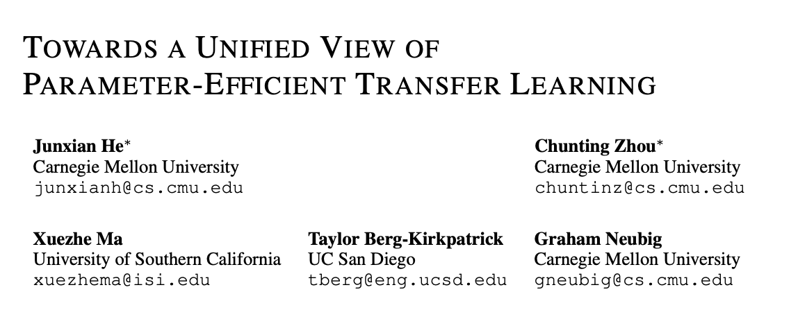

Slide 18
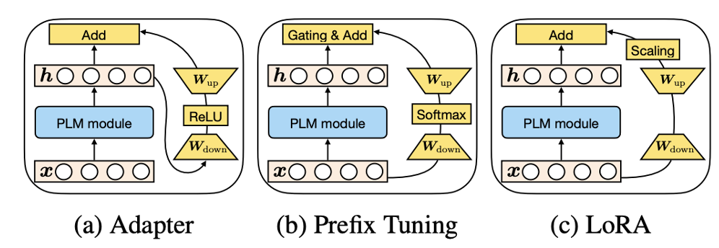
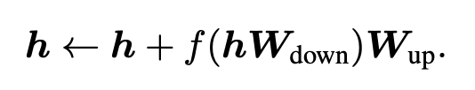
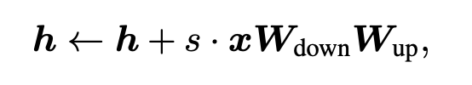
Overview of Previous Methods
Adapter
Prefix Tuning
LoRA
Notes:
Plm module的指代不同

Slide 19
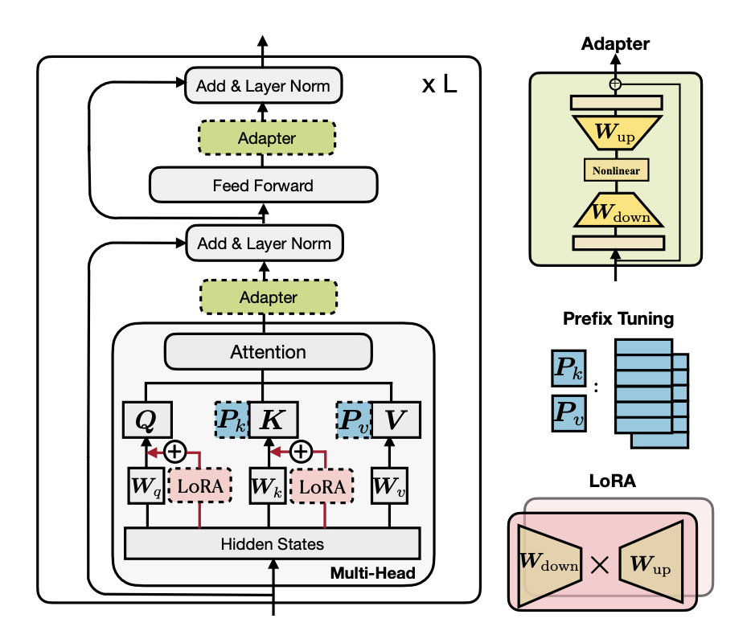
Background
How are these methods connected?
Do these methods share design elements that are essential for their effectiveness, and what are they?
Can the effective ingredients of each method be transferred to others to yield more effective variants?

Slide 20
Overview of Previous Methods
Adapter
Prefix Tuning
LoRA

Slide 21
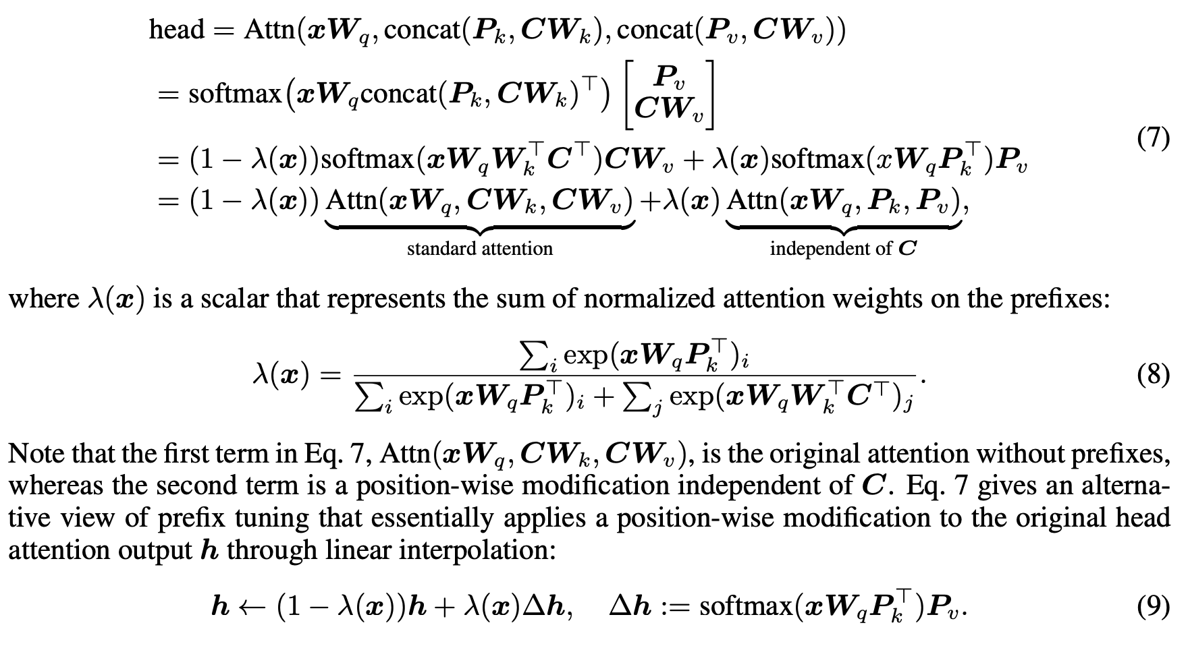
An alternative view of prefix tuning

Slide 22

Adapter
Prefix Tuning
LoRA
Notes:
Difference:
Sequential vs parallel
Where to apply

Slide 23
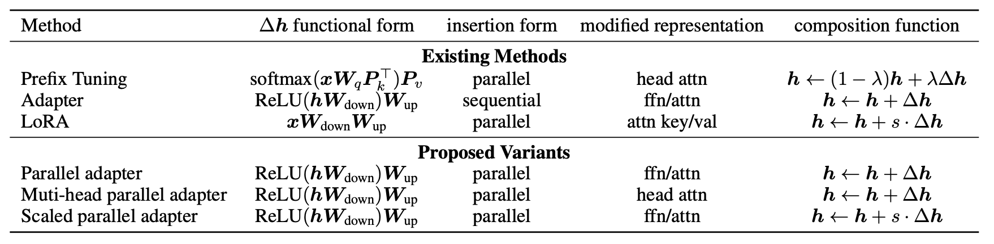

The Unified Framework
Cast them as learning a modification vector ∆h, which is applied to various hidden representations.
$$h←h+∆h$$

Slide 24
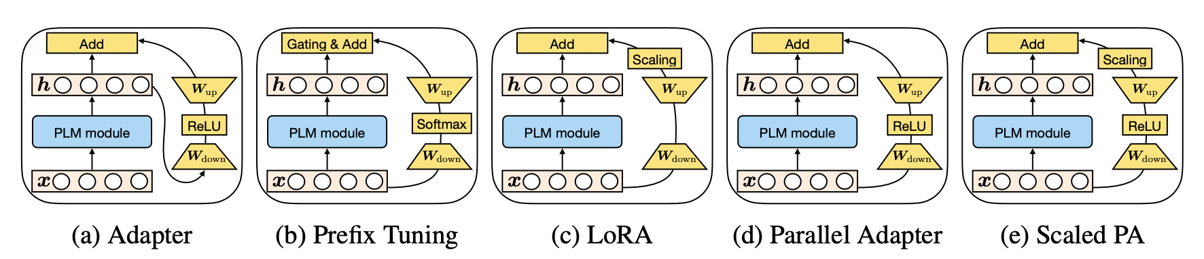

Slide 25
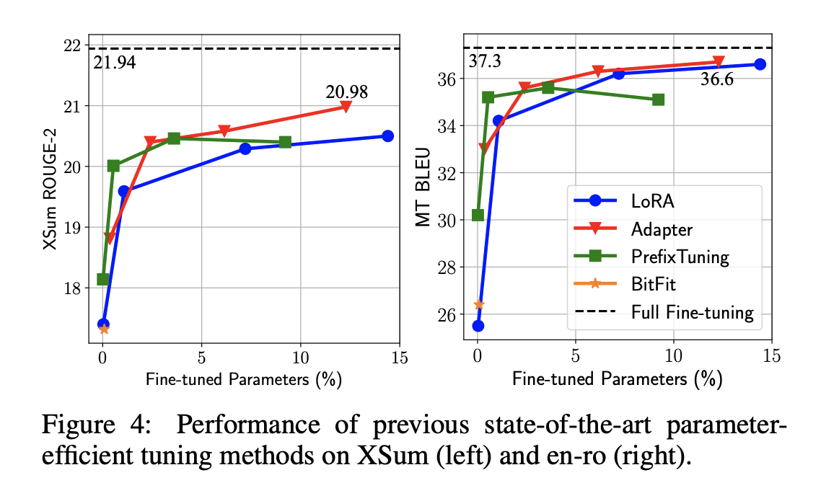
The Results of Existing Methods

Slide 26
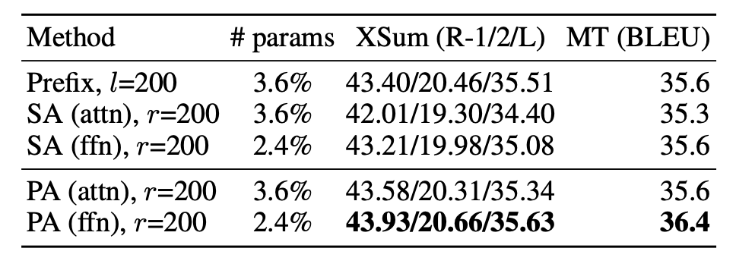
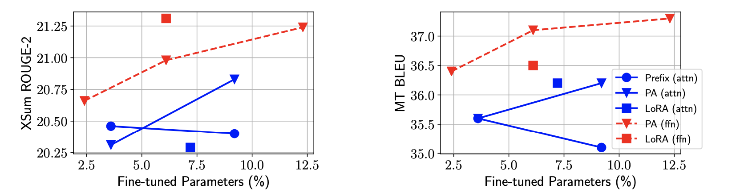
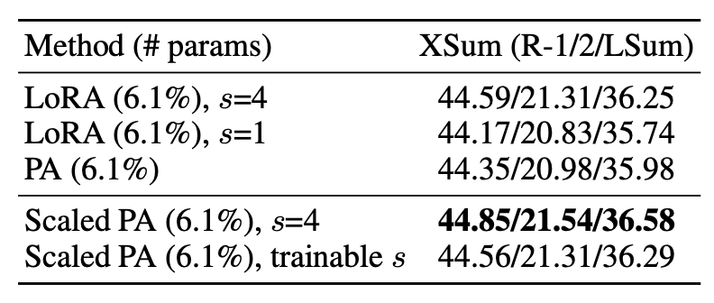
Which insertion form – sequential or parallel
Which modified representation – attention or FFN
Which composition function ?
Simple addition (Adapter)
Gated addition (Prefix tuning)
Scaled addition (LoRA)
Scaled parallel adapter is the best variant to modify FFN

Slide 27
An Effective Integration by Tranferring Favorable Design Elements
Findings
Scaled parallel adapter is the best variant to modify FFN
FFN can better utilize modification at larger capacities
Modifying head attentions like prefix tuning can achieve strong performance with only 0.1% parameters
Mix-And-Match adapter (MAM adapter)
use prefix tuning with a small bottleneck dimension (l = 30) at the attention sub-layers and allocate more parameter budgets to modify FFN representation using the scaled parallel adapter (r = 512)
6.7% parameters

Slide 28
